Slide 1
Sales Training
Straight Line Selling
Tie-Down Price
Opening
HOLD
Tie-Down 3x
Close
Prequalify
Credibility
Teaser
Benefits
Rebuttals

Slide 2
Tonality
There are 3 types of tonality:
Breaking Rapport – Down tone or falling tone
Seeking Rapport – Up tone or Rising tone
Neutral Rapport – Even tone or monotone
In phone sales we do not have the ability to use our body language to our advantage. Therefore, it is critical we use proper inflection and tone throughout the call.
You want to sound like you are a professional who is HAPPY to be doing their job. The customer feels what you feel.
You want to mirror the customers energy level, but slightly higher, maybe 5%-10% more energy.
Too much energy and you sound like a clown, its overbearing and you will not get a good reaction.
If you don’t have enough energy you will sound unsure of yourself and I promise the objections will come.
Speak clearly and emphasize your words. Do not use slang. Do not use ANY curse words EVER. Even if the customer swears. Speak like a professional. That’s who they want to buy from – someone who knows what their talking about, and SOUNDS LIKE THEY KNOW WHAT THEY ARE TALKING ABOUT!

Slide 3
Opening
Open the call using breaking rapport tonality if on an outbound call. Sound happy to be working here, the customer hears your tonality and feels what you feel.
Open the call at a slow steady pace, it is counterintuitive, but people are more likely to listen if you aren’t rushing your words out before they hang up.
Assume it is the customer you are speaking with, do not ask for them or give them the opportunity to tell you an excuse that it is not them.
If the opposite gender answers assume it’s the spouse and continue. They will tell you if it is not correct information
When the customer goes off on a tangent about their situation do not dig deeper into it as this will make the call a mess, instead acknowledge what they say, respond with a redirect, and continue.
Say Yourself/ Your family, VS Individual or Family Plan.
1. Everyone else at all the other call centers are saying individual or family everywhere else, this makes us different.
2. This will immediately let you know if they are looking for someone else that may not even be there and can avoid wasting time if they aren’t the payor. Example: a friend who is just gathering information and is not the payor. Be sure to do a very solid prequal to find out if they would pay for it, if the payor is near by. (Don’t call them the payor on the phone.)

Slide 4
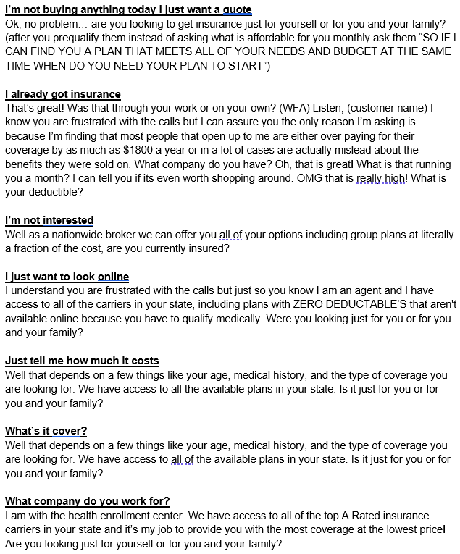
Outbound Opening Objections

Slide 5
Prequalify
Pre QualificationCentral Health Advisors, this is (FIRST AND LAST NAME). I’ll be your licensed health insurance agent assisting you today. Please note that this call may be recorded for training and quality assurance. Were you looking for an individual or family plan TODAY? (IF INDIVIDUAL) - (Move on to next question) (IF FAMILY) - And how many family members will be included onto the plan TODAY? OK! GREAT! Now are you currently insured? ✔ (IF YES) And do you have that plan through the state, Marketplace, or through your employer?✔ (IF YES) And just so I know how to HELP you today, were you looking for better coverage, lower rates, or is your policy expiring? ✖ (IF NO) Just so I know how to better HELP you, how long have you been without coverage? Do you have any pre-existing medical conditions I should be aware of? Are you currently taking any medications you’d like me to make sure are covered? What is your Date of Birth? Please verify your zip code? Are you a tobacco user? On average, how many times would you say that you go to the doctors on a yearly basis? Do you have any doctors that you would like to keep in the network, just so I can place you into a plan that they participate in? Do you have any upcoming surgeries, procedures or any treatments scheduled?
This is the section is Conversational. Talking back and forth
You want to gather information to determine eligibility and at the same time listen to the customers needs, buying points, and medical information which can be used to determine the best plan.
Once we are out of the prequalify section, we will be switching the speaking to more of a 90% talking 10% listening
They more information you get them to tell you, the more they will buy into the process, the easier of a sale you will create, however, if you let them go too far off on a tangent it will hurt the sale.
This section shouldn’t take more than 5-10 minutes before you’re tying them down on a price. If you are exceeding 10 minutes you're doing it wrong. If you are tired of getting to the money and then getting tons of objections after they sounded good throughout the call, this is why. If you do this part and the tie down correctly, 90% of your sales will be lay downs and 10% will need rebuttals.
If they say they want Medicaid, say no problem I can help you see if you qualify for that. GO RIGHT BACK TO THE SCRIPT AND READ IT WORD FOR WORD, in the next section where you ask their annual income just tell them they unfortunately do not qualify for Medicaid because their income is too high, or because they are only accepting pregnant women at this time (depending on who you are talking to) and then tell them however I do see that you may qualify for a health insurance policy at a discounted rate due to their income level and give them the lowest price range you can offer in that state and get them to commit to it.

Slide 6
Tie Down Price
The first 4 questions we ask in the tie down section is for us to figure out their income. We ask them this way because that’s how the marketplace does it, people are used to answering these questions. The first 4 questions we ask in the tie down section is for us to figure out their income. We ask them this way because that’s how the marketplace does it people are use to answering these questions.
In this paragraph we are letting the customer know who we are, What we do, Why they no longer need to shop around, That we have a formula that works, We also build urgency by letting them know we are going to put them on hold which creates anticipation when we return. Ping your OK’s
When you ask for the budget, it is imperative that you get THEM to TELL YOU what is affordable. If you put the words in their mouth instead of them telling you it will not have nearly the same effect.
If the customer is telling you they want the cheapest thing possible or they do not know what the plans go for, rather than being combative and trying to force a number out of them, we will tell them we’re going to start with the most affordable option and go from there. This seems to work better for a few reasons.
Sometimes they just don’t know what they cost
Sometimes they just need to see the value first
Sometimes they can afford more than they are leading on
Make sure you are putting the state in the drop down as soon as you know their zip code
Perfect! Now to see if you may qualify for any state programs or any government subsidies, how much money do you make on a yearly basis BEFORE TAX? Is there a monthly price range you’re hoping to stay within so I can narrow down the best options? Excellent. Assuming we find the right fit, how soon would you like your coverage to begin? Perfect. I’m going to submit your information into my system now so I can pull up all of your available options. Give me about 30 to 60 seconds while I review everything, and I’ll be right back with you.(THIS IS THE SIZZLE!!!!)

Slide 7
Tie Down Price
(IF THEY START TELLING YOU WHAT THEY WANT IT TO COVER INSTEAD OF ANSWERING THE BUDGET WAIT FOR THEM TO FINISH TALKING AND THEN REPLY.)
OK, I understand, and of course I will find a plan that will meet ALL of your needs, I just want to make sure that I don’t put another bill on your table that is going to stress you out every month. It doesn’t do either of us any good if I put you into a plan, and then 2-3 months from now it isn’t affordable for you, and you end up cancelling it… because then it doesn’t matter how good the benefits are if you can’t afford to keep it, so what would you say IS affordable for you monthly?
(IF THEY SAY WELL TELL ME WHAT YOU HAVE TO OFFER)
Well, we work with ALL of the TOP “A” Rated Insurance companies in the country so I have plans that are anywhere from $200 a month all the way up to $1500 a month… It really just depends on what you need it to cover, what you can qualify for, and whether or not you can afford it each month… realistically because of your age you are probably looking somewhere along the lines of around $(give realistic range), does that sound feasible for you?
You should already know what plan you are going to sell them based on the prequalify section and tying down budget BEFORE you are even putting them on hold. The hold is strictly to build urgency.
Just in case you haven’t though, you do have some time to get organized.
DO NOT leave them on hold longer than 2 minutes
Aside from what is in your script these are the other most common responses you will get

Slide 8
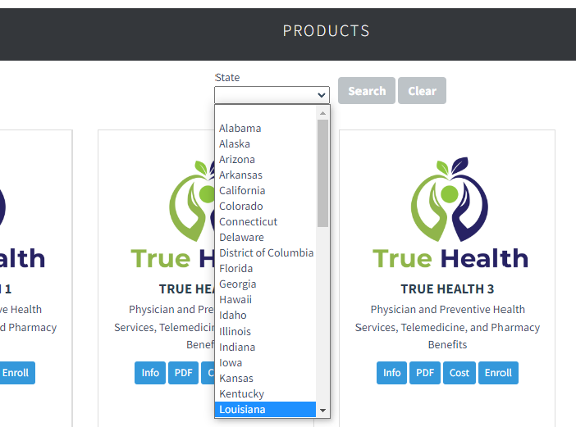
Selecting the right plan
We want to select the plan based off the state they are in because its required, but the most important factor is the budget. Either choose a plan slightly under the price they gave you if they are lower income or slightly higher than the price they gave you if they have higher income.
If the customer, however, tells you they are on a plan now and are paying xx amount that’s very expensive (like cobra) all you must do is come in low enough where it’s a no brainer decision to purchase but high enough to where they don’t find it too good to be true.

Slide 9



Type of plans we offer
INDEMNITY
- HAVE NO DEDUCTIBLE
-USES NETWORK REPRICING AND INDEMNITY CASH BENEFITS TOWARDS CLAIMS
MEC
- HAVE NO DEDUCTIBLE
-USES NETWORK REPRICING AND INDEMNITY CASH BENEFITS FOR HOSPITAL
-USES COPAYS FOR DR. VISITS
STM
- HAS DEDUCTIBLE, COINSURANCE, MAX OUT OF POCKET
-HAS COPAYS FOR DR. VISITS
-HAS POLICY MAXIMUMS

Slide 10
Limited Medical Indemnity Plans
Also known as Large Group Association Insurance Plans or Private Market Insurance
They are not considered Major Medical “Obamacare”
They are “No Deductible” insurance plans
They are guaranteed issue which means anyone can enroll regardless of health – however, we do not want to tell the customer this as it takes away urgency and leverage

Slide 11
Mec Plans
Mec – Minimum Essential Coverage
They are a hybrid version between Indemnity and STM
They have copays for doctors visits and indemnity benefits for the hospital
Wellness and Preventative care is free
Preventive Generic medications are free

Slide 12
STM Plans
These are comparable to comprehensive major medical plans
They have deductibles, co-insurance, maximum OOP, policy maximums and set copays
The customer must qualify medically – there are knock out medical questions
These are going to be more expensive as the customer is older and less expensive for younger customers
These are what you want to offer to people who are educated about the insurance market and are familiar with Major Medical

Slide 13
Ancillaries
Accidental Death and Dismemberment (AD&D)
Whenever the customers budget allows you want to add the AD&D to the plan. This pays a lump sum amount to the customers beneficiary if they pass away due to an accident or pays a percentage of the benefit amount if loss of limb occurs.
Critical Illness
Add this on if you do not have access to AD&D or would like to add both the plan. Critical Illness pays a lump sum amount to the customer directly if the customer is diagnosed with a covered critical illness such as cancer or stroke.
Dental
Telemed
Gives the customer access to board certified physicians 24/7 via the phone or video chat. Unlimited visits and no cost to the customer. This also increases your commission substantially.

Slide 14
Teaser
✖ ( DO NOT ASK IF THEY ARE STILL THERE)
Alright [Customer Name], I have some excellent news for you. Based on the information you provided, I was able to locate a plan for you through the Multiplan Network/FirstHealth Network. This plan offers fixed benefits for doctor visits, hospital care, and prescription savings. You have the flexibility to see any provider within the network, and there’s no requirement for referrals to visit a specialist. Another key advantage is nationwide access—this coverage can be used anywhere the network is accepted. And most importantly, there is no deductible. Does everything sound clear so far? ▶ ( Wait for Answer )
“Great. Based on everything we’ve reviewed, the monthly rate for this plan comes out to $___. There is a one-time standard group association fee of $___ to activate your membership within the plan. That brings the total for the first month to $___, and then moving forward, your monthly cost is simply $___ thereafter. Now, assuming this plan meets your medical needs, would the initial first-month amount of $___ be affordable for you today?” ▶ ( Wait for answer )
Perfect. What I’ll do next is walk you through the full benefits of the program. If everything looks good to you, we’ll move forward with submitting the application to the insurance company. During the verification process, you’ll receive an email that includes an outline of your coverage along with digital insurance cards. Your physical cards will then arrive by mail within approximately one to three weeks. Okay? ▶ ( Wait for answer )
Let’s start by reviewing how your doctor visits work so you can see how the plan functions, and then—if everything looks good—we’ll move forward with submitting the application. Sounds good?
When you come back from the hold DO NOT ask if they are still there. Assume they are there and start speaking immediately.
When you come back from the hold you need to use a slightly higher energy than in the previous sections of the script. You need to speak at a pace steady enough where the customer can not interrupt you.
You will notice that these paragraphs are pretty much identical, it comes down to carrier name/network or if it is an STM including the deductible.
The 2nd paragraph is tying them down on price. We will address this on the next slide as well.
The 3rd uses imagery to paint a picture of what's going to happen. People are a lot more receptive to ideas when they can visualize what's happening. This is letting the customer know they will receive it in writing beforehand to help eliminate that objection.
Again we should be speaking 90/10 to the customer
Maintain a pace where the customer doesn’t interrupt you but not too fast to sound like a clown
PING your OKs

Slide 15
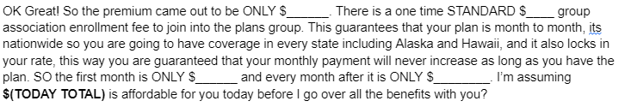
Tying Down Price
When you are giving the customer the price, make sure you are remembering to tell them the enrollment fee
If you forget to tell them the enrollment fee up front it will cause an issue when you tell them later in the call or if they see it on the DocuSign.
When you tell them the price 1 of 5 things will happen:
They will agree and say it is affordable
They will say its not affordable
They will say it sounds good, but I need to think about it
They will say it sounds good, but I want to see it in writing
They will say it sounds good, but I got to talk to my spouse
If they say it's affordable than continue.
If they say it's not affordable we need to find out if its just the first month that’s not affordable today, or if it is the monthly payment.
If it's just a matter of the enrollment fee we can apply for “hardship” to see if we can lower the enrollment fee. It is imperative you determine they have enough money TODAY, BEFORE you lower the enrollment fee.
If they don’t have enough money today even if you were to lower the enrollment fee then we will go for a Post Date.
3. If they say it's sounds good but I need to think about it or talk to my spouse we are going to repeat their words back to them and pivot into the next paragraph:
I understand you need to think about it but right now there is nothing to really think about yet because we didn’t go over how the plan works, and secondly, we don’t even know if you are approved yet, so what I normally do is…
I understand you want to talk to your husband/wife but right now there is nothing to talk about yet because we didn’t go over how the plan works, and secondly, we don’t even know if you are approved yet, so what I normally do is…
You are going absolutely going to to get it in writing, that’s going to be the next step after we go over the benefits together so what I normally do is…

Slide 16
Benefits
You don’t need referrals to see a specialist. When you visit a doctor, the bill is first reduced to the network’s contracted rate, and then your doctor visit benefit is applied. So if a provider bills higher, the network adjusts it first, and your benefit helps cover the cost after that. ▶ ( Wait for Answer )
People like this plan because it’s simple. Unlike traditional plans with deductibles and coinsurance, this plan has no deductible and pays defined benefit amounts toward covered services—so you know what the plan contributes and can plan your expenses more easily. ✖ ( DO NOT WAIT - GO TO RX )
RX:
You’ll also receive access to a prescription discount program you can use at major pharmacies. Discounts vary, but many members find it helpful. The plan does not include benefits for mental health, substance abuse, or pregnancy-related care. You won’t be needing coverage for those services, correct?” ✖ ( DO NOT WAIT GO RIGHT TO CLOSING STATEMENT )
CLOSING STATEMENT
Your coverage is scheduled to start on ______, pending enrollment and verification. You can see in-network providers with no referral required, and the plan includes day-to-day benefits and fixed hospital benefits, all with no deductible. Before we proceed, can you confirm that everything we’ve reviewed about the plan and its limitations has been explained and understood? ▶ ( Wait for Answer )
At this point the only time the customer should be speaking is when you prompt them to respond
If they are saying things like “oh that’s great” “wow that sounds good” you shouldn’t even acknowledge it
If the customer has a question about something haven’t gotten to yet, use ARC (we will go over later in presentation).
Reading the benefits VERBATIM will keep you compliant and make the sales process A LOT smoother.
DO NOT USE TOO MUCH ENERGY OR YOU WILL GET TOO GOOD TO BE TRUE/LEGITIMACY OBJECTIONS
You should sound like you are happy doing what you do but at the same time this is no big deal for you because you have done this a million times and you have the customers best interest at heart.
Do not add or leave out anything in the script everything is written the way it is for a reason. When you give the customer TOO much information you are shooting yourself in the foot – they’re going to need to think about it.
LESS IS MORE – DO NOT TELL THEM A REPRICING PERCENTAGE IF THEY DON’T ASK

Slide 17
Close
CLOSING STATEMENT
Your coverage is scheduled to start on ______, pending enrollment and verification. You can see in-network providers with no referral required, and the plan includes day-to-day benefits and fixed hospital benefits, all with no deductible. Before we proceed, can you confirm that everything we’ve reviewed about the plan and its limitations has been explained and understood? ▶ ( Wait for Answer )
OK Perfect, what is a good email we can send all this over to?
Would you like your insurance cards issued with a middle initial, or just your first and last name?
What is the physical mailing address where we should send your hard-copy documents to?
Great. And just to confirm, is this phone number ________ the best number for the insurance company to reach you if they have any follow-up or verification questions?
Before we complete the enrollment, I do need to verify a few items on this recorded line. Can you please confirm that you are a United States citizen or legal resident, and that all health information you provided today is accurate and complete to the best of your knowledge? Lastly, for identity verification purposes, please confirm your Social Security number? ▶ ( Wait for Answer )
For the initial payment, which card type would you prefer you put on file? ▶ ( Wait for Answer )
Ok go ahead with the card number. (OR) I’m ready for the card number when you’re ready. ✖ ( DO NOT SPEAK WHOEVER TALKS FIRST LOSES )
Read the closing statement, it provides a smooth transition into the application.
If the customer says yes its affordable JUST READ THE CLOSING STATEMENT AND ASK THE FIRST/LAST NAME MIDDLE INITIAL QUESTION
The first closing question is middle initial or first and last name. This is called a close ended question – which means we give them 2 options that both work for us. An OPEN-ended question gives away some control of the call. An example of an Open-ended question is, “How are you doing today?”… The difference is the degree of possible responses you can receive.
DO NOT PRE-EMPT ASKING FOR THE MONEY OR STARTING THE APPLICATION
THIS MEANS DO NOT SAY THINGS LIKE THE NEXT STEP IS TO DO AN APPLICATION I’M GOING TO SEND YOU AN DOCUSIGN ETC
THIS IS KILLING YOUR SALES AND KILLING EVERYTHING YOU DID FROM START TO FINISH OF THE CALL
ITS LITERALLY ONE OF THE WORST THINGS YOU CAN DO IN PHONE SALES

Slide 18
Close Continued….
CLOSING STATEMENT
Your coverage is scheduled to start on ______, pending enrollment and verification. You can see in-network providers with no referral required, and the plan includes day-to-day benefits and fixed hospital benefits, all with no deductible. Before we proceed, can you confirm that everything we’ve reviewed about the plan and its limitations has been explained and understood? ▶ ( Wait for Answer )
OK Perfect, what is a good email we can send all this over to?
Would you like your insurance cards issued with a middle initial, or just your first and last name?
What is the physical mailing address where we should send your hard-copy documents to?
Great. And just to confirm, is this phone number ________ the best number for the insurance company to reach you if they have any follow-up or verification questions?
Before we complete the enrollment, I do need to verify a few items on this recorded line. Can you please confirm that you are a United States citizen or legal resident, and that all health information you provided today is accurate and complete to the best of your knowledge? Lastly, for identity verification purposes, please confirm your Social Security number? ▶ ( Wait for Answer )
For the initial payment, which card type would you prefer you put on file? ▶ ( Wait for Answer )
Ok go ahead with the card number. (OR) I’m ready for the card number when you’re ready. ✖ ( DO NOT SPEAK WHOEVER TALKS FIRST LOSES )
The next closing questions are not just asked because we need them on for the application. We leverage this opportunity to use imagery to speak with the customers subconscious mind to make them feel comfortable giving us information.
The way that we ask for the information is important. Asking for the phone number and email like this talks to their subconscious mind. It makes them comfortable providing the information and it also takes away the need for them to receive something in writing because we reinforce they are going to receive something.
Without hesitation or discussing payment date we ask for the money. Do not beat around the bush.
Ask calmly because the customer feels what you feel. If it is no big deal to you, it will be no big deal to them.
We are going to assume every sale is a “pay today” unless the customer tells you otherwise. Remember, in the beginning of the call get them to commit to a realistic price and then after the hold we tell them its going to start tomorrow. They will either tell you on the 3 tie downs, or NOW whether or not they have the money today. If they do not have it then post date the sale. Otherwise we ALWAYS assume the customer is paying today. Doing it this way will not result in a large amount of postdates. However, you will have days where you write 3 fresh, 3 postdates, 5 fresh 1 postdate, 2 fresh 4 postdates. It is NOT encouraged to PUSH the postdate, however, if that’s when they get paid then that’s when it is ok to postdate. Whether or not your postdates go through will be based on how well you tied them down on the price in the beginning of the call. You should NEVER be getting this far with someone who can't afford this monthly.

Slide 19
Verification Signature and Post Close
VerificationThis is the final step. I’m sending you a text now from a 732 number labeled ‘ONE ENROLLMENT.’ Please click the link once you receive it. Let me know when you see it. ▶ ( Wait for Answer ) Great. Please open the link and, if possible, place your phone on speaker so I can walk you through the document. Your role here is simply to confirm that everything has been entered correctly. I’ll have you verify the spelling of your first and last name, your home address, email address, and phone number, as well as confirm that your date of birth and gender are accurate. I’ll also ask you to confirm the payment method on file and the billing address associated with the application. Once you’ve reviewed everything, let me know—does it all look correct?” ▶ ( Wait for Answer) As you scroll down, you’ll see what’s called a bill-by-benefit breakdown. It’s just a transparent summary showing how the policy is set up and how the cost is allocated across the benefits. (Everest has 1 check box asking consent for email in the middle of the verification.) At the bottom, enter your first and last name—please capitalize both. Then sign electronically with your finger. You can leave the last checkbox unchecked unless you’re applying for your child only. Click ‘Accept’ and tell me what you see. (You've successfully signed your document)Notes: ▶ If needed: Don't forget to enroll customer GoodRX Account. ▶ You will need a verification code from the customer. Via TEXT. ▶ Remind customer to use GoodRX and not their insurance card at the pharmacy. Customer provides pharmacist of their GoodRX Account.
Read the Verification page
Get them to sign
Read the Post Close – it will help your sales stick

Slide 20
Post Close – Limited Medical
Post Close Perfect—I’ve received your signature on my end. I’m going to go ahead and submit your application to the insurance carrier now. ✔ ( If it goes through ) Congratulations [Customer Name], your application is complete. Do you have a pen and paper? Our customer service number is 855-736-1590, available Monday through Friday, 9:00 a.m. to 9:00 p.m. Eastern. I’ll also provide you with my direct extension for future reference.Your confirmation number is CHA561337—please keep that for your records. If anyone calls claiming to be from our agency and can’t provide that number, they’re not affiliated with us.Now go ahead and write down MULTIPLAN NETWORK - FIRST HEALTH NETWORK.The website you can visit to search providers is:providersearch.multiplan.com - providerlocator.firsthealth.comWith today’s payment, your policy will become effective on _______. Your second payment will then be due 30 days from that effective date. ( If it’s a postdate, make sure you state the dates correctly for the first billing date and the effective date )You’ll receive two ID cards by mail about 7 to 10 business days after your effective date. One is a discount card for prescriptions and other added benefits like dental and vision. The second card is your actual insurance ID card and will clearly show MULTIPLAN NETWORK - FIRST HEALTH NETWORK. Just for your records, I want to quickly recap the main details you’ll see in your paperwork. Your plan uses the Multiplan Network/ FirstHealth Network for doctors and hospitals. The insurance benefits are underwritten by Everest Reinsurance Company / American Financial Security Life Insurance Company and offered through the National Congress of Employers (NCE). Your monthly billing is handled through FirstEnroll, which is the name you’ll see on your statements. All of this will be clearly outlined in your policy documents. I do want to clarify that this is a private, limited-benefit plan, not an ACA or major medical plan, and it does not provide coverage for maternity, substance abuse, or psychiatric services.- I also want to explain the 12 and 12 pre-existing condition clause, which states anything diagnosed in the last 12 months would have a 12-month waiting period. There is a standard 30-day waiting period for any hospital,sickness and scheduled doctor visits.If you have any friends or family members that need quality coverage, please give them my information, it would be greatly appreciated. We will find them the right plan just as we did for you. Alright [Customer Name], you've been an absolute pleasure. Now do you have any questions before we disconnect?✖ ( DO NOT ASK IF THEY ARE STILL THERE )

Slide 21
Post Close – Access STM
Post Close
Perfect—I’ve received your signature on my end. I’m going to go ahead and submit your application to the insurance carrier now. ✔ ( If it goes through )
Congratulations [Customer Name], your application is complete. Do you have a pen and paper? Our customer service number is 855-736-1590, available Monday through Friday, 9:00 a.m. to 9:00 p.m. Eastern. I’ll also provide you with my direct extension for future reference.
Your confirmation number is CHA561337—please keep that for your records. If anyone calls claiming to be from our agency and can’t provide that number, they’re not affiliated with us.
Now go ahead and write down MULTIPLAN PHCS NETWORK.
The website you can visit to search providers is: providersearch.multiplan.com
With today’s payment, your policy will become effective on _______. Your second payment will then be due 30 days from that effective date. ( If it’s a postdate, make sure you state the dates correctly for the first billing date and the effective date )
You’ll receive two ID cards by mail about 7 to 10 business days after your effective date. One is a discount card for prescriptions and other added benefits like dental and vision. The second card is your actual insurance ID card and will clearly show MULTIPLAN PHCS NETWORK.
Just for your records, I want to quickly recap the main details you’ll see in your paperwork. Your plan uses the Multiplan PHCS Network for doctors and hospitals.
The insurance benefits are underwritten by American Financial Security Life Insurance Company and offered through the National Congress of Employers (NCE).
Your monthly billing is handled through FirstEnroll, which is the name you’ll see on your statements. All of this will be clearly outlined in your policy documents.
I do want to clarify that this is a private, short term health plan, not an ACA or major medical plan, and it does not provide coverage for maternity, substance abuse, or psychiatric services.
- I also want to explain the 12 and 12 pre-existing condition clause, which states anything diagnosed in the last 12 months would have a 12-month waiting period. There is a standard 30-day waiting period for any hospital,sickness and scheduled doctor visits.
If you need to add or change dependents in the future, that can be done on the plan’s annual anniversary, without having to cancel your coverage.
If you have any friends or family members that need quality coverage, please give them my information, it would be greatly appreciated. We will find them the right plan just as we did for you.
Alright [Customer Name], you've been an absolute pleasure. Now do you have any questions before we disconnect?

Slide 22
Post Close - MEC
Post Close
Perfect—I’ve received your signature on my end. I’m going to go ahead and submit your application to the insurance carrier now. ✔ ( If it goes through )
Congratulations [Customer Name], your application is complete. Do you have a pen and paper? Our customer service number is 855-736-1590, available Monday through Friday, 9:00 a.m. to 9:00 p.m. Eastern. I’ll also provide you with my direct extension for future reference.
Your confirmation number is CHA561337—please keep that for your records. If anyone calls claiming to be from our agency and can’t provide that number, they’re not affiliated with us.
Now go ahead and write down FIRST HEALTH NETWORK.
The website you can visit to search providers is: providerlocator.firsthealth.com
With today’s payment, your policy will become effective on _______. Your second payment will then be due 30 days from that effective date. ( If it’s a postdate, make sure you state the dates correctly for the first billing date and the effective date )
You’ll receive two ID cards by mail about 7 to 10 business days after your effective date. One is a discount card for prescriptions and other added benefits like dental and vision. The second card is your actual insurance ID card and will clearly show FIRST HEALTH NETWORK.
Just for your records, I want to quickly recap the main details you’ll see in your paperwork. Your plan uses the FirstHealth Network for doctors and hospitals.
The Plan Administrator / Claims Administrator: Merchants Benefit Administration (MBA)
Your monthly billing is handled through FirstEnroll, which is the name you’ll see on your statements. All of this will be clearly outlined in your policy documents.
I do want to clarify that this is a private, limited-benefit plan, not an ACA or major medical plan, and it does not provide coverage for maternity, substance abuse, or psychiatric services.
- I also want to explain the 12 and 12 pre-existing condition clause, which states anything diagnosed in the last 12 months would have a 12-month waiting period. There is a standard 30-day waiting period for any hospital,sickness and scheduled doctor visits.
If you have any friends or family members that need quality coverage, please give them my information, it would be greatly appreciated. We will find them the right plan just as we did for you.
Alright [Customer Name], you've been an absolute pleasure. Now do you have any questions before we disconnect?

Slide 23
Sales Tactics - ARC
ARC is a sales technique used to redirect a conversation back into your control.
A – Acknowledge: Acknowledge what they said so it seems like you care about them
R – Respond: Respond in a relevant manner to redirecting back to pitch
C – Continue: Ask the next question, repeat current question, or continue in script.
Examples:
“That’s a great question Joe, I’m going to go over that with you in just a minute but I need to know a little more about your situation first, what is your date of birth?”
“I understand Mary, I’ll make sure I explain all of that in a minute, do you have any sort of pre-existing medical conditions or take any prescriptions?”
“Thanks for sharing that with me, I think I can help you, What is your zip code?”
“We’re going to find out how much it costs in just a minute I just have a couple more quick questions so we can get an accurate quote”

Slide 24
Sales Tactics - MISC
Stop OVERTALKING – less is more
Don’t say words like basically or actually
Don’t say things like honestly, I’m going to be honest with you
Don’t say UM OR UH – it makes you sound like you don’t know what you’re talking about
I’ll say it again DO NOT ADD THINGS TO THE SCRIPT THAT YOU THINK SOUND GOOD, IT DOESN’T AND ITS KILLING YOUR SALES
If you just read the script word for word without adding anything or skipping anything this will make it SO EASY for you.
When you are doing the application flip to the rebuttals section and BE READY for objections
There are ONLY 2 reasons why someone doesn’t buy, NO MATTER WHAT THE OBJECTION IS. Money or Legitimacy

Slide 25
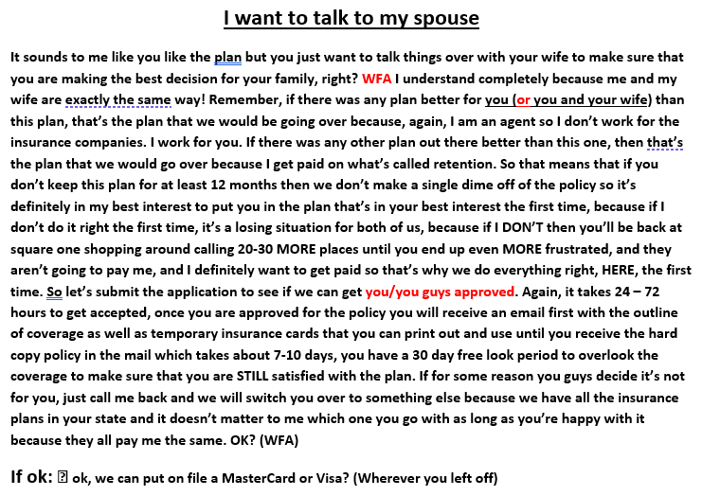
Objections and Rebuttals:

Slide 26
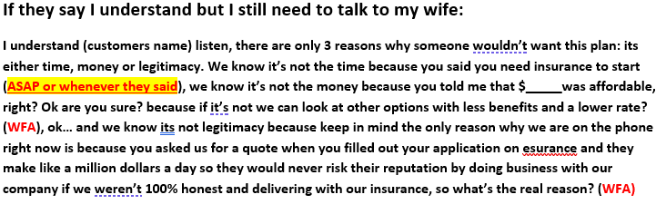
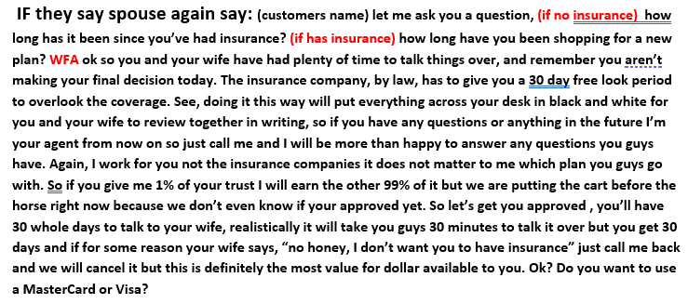
Objections and Rebuttals Continued:

Slide 27
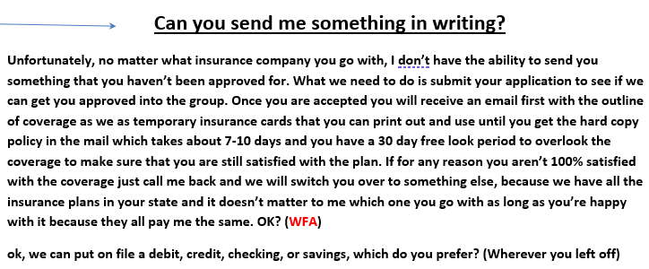
Objections and Rebuttals Continued:

Slide 28
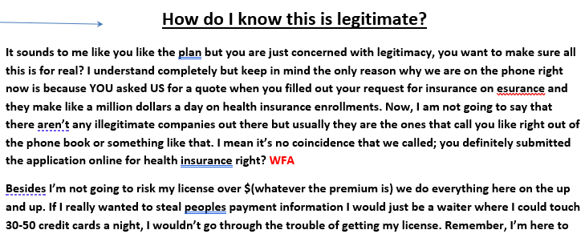
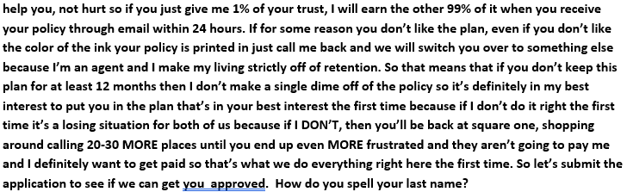
Objections and Rebuttals Continued:

Slide 29
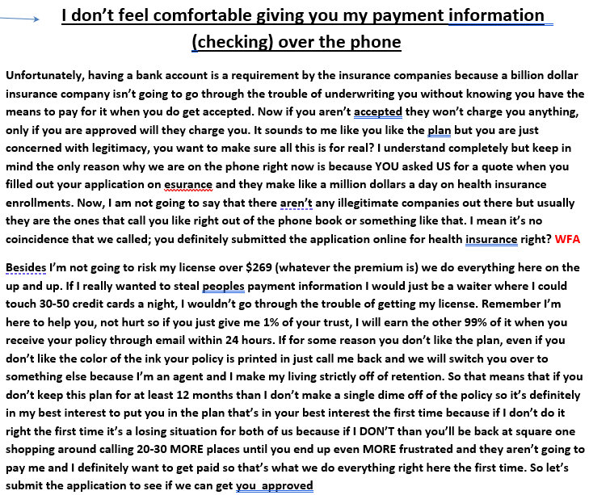
Objections and Rebuttals Continued:

Slide 30
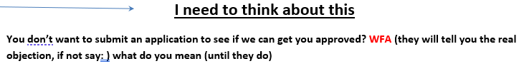
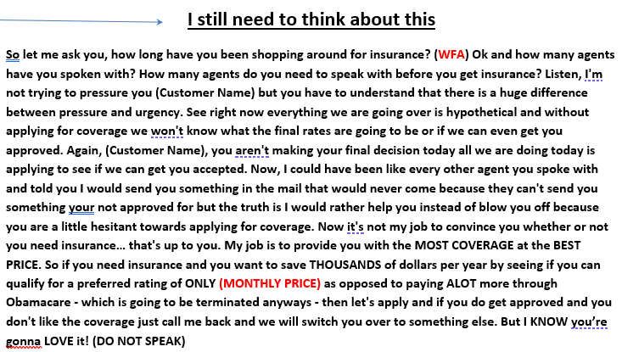
Objections and Rebuttals Continued:

Slide 31
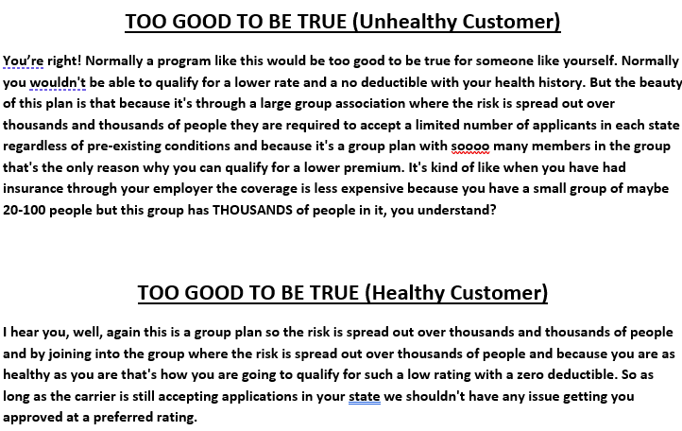
Objections and Rebuttals Continued:

Slide 32
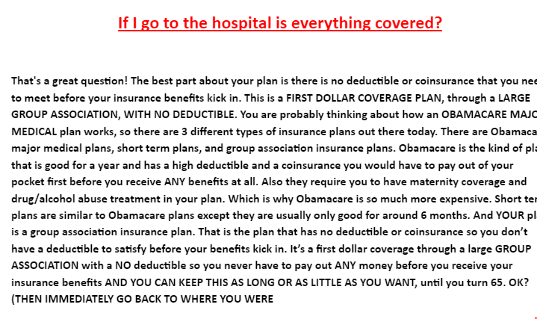

Slide 33
Other key factors to success:
Do not waste time with prospects that are not interested. Get rid of jokers, rude people, jerks, ballbusters. We are here to sell insurance.
If you want to make serious money then take your business serious.
Your goal should be to pitch as many people as you can… If one sale takes 20 minutes average and pays $121+ per sale on average you know for a fact that it takes a minimum of 2 hours of pitching to write 5 sales which pays $600 in a day, or $3000 a week.
But it takes 5-6 hours of available time a day to get off 5 sales because of the time it takes to connect with a customer that fits our product either due to budget or qualification.

